Slide 1
Sujata Budhathoki, Prabin Rokaya and Karl-Erich Lindenschmidt Acknowledgment: Mohamed Elshamy, Bruce Davison, Al Pietroniro, Daniel Princz and all Current Generation Modelling Team
Impacts of future climate on the hydrology of Saint John River Basin in eastern North America
May 18, 2020

Slide 2
Introduction
Atlantic Canada is one of the many regions in Canada threatened by global climate change.
Impacts of future climate on hydrology of an important Atlantic river basin, i.e., the Saint John River Basin (SJRB) is poorly understood (very few studies).
But we need an appropriate water system modelling tools that can describe climate change and anthropogenic response in watershed to identify efficient and effective adaptation strategies.
Research objective: Benchmarking model runs for the Saint John River Basin (SJRB) and assessing the impacts of future climate on the hydrology.
Notes:
Water security faces unprecedented challenges due to population growth, economic development, poor governance, and land-use and environmental change.

Slide 3
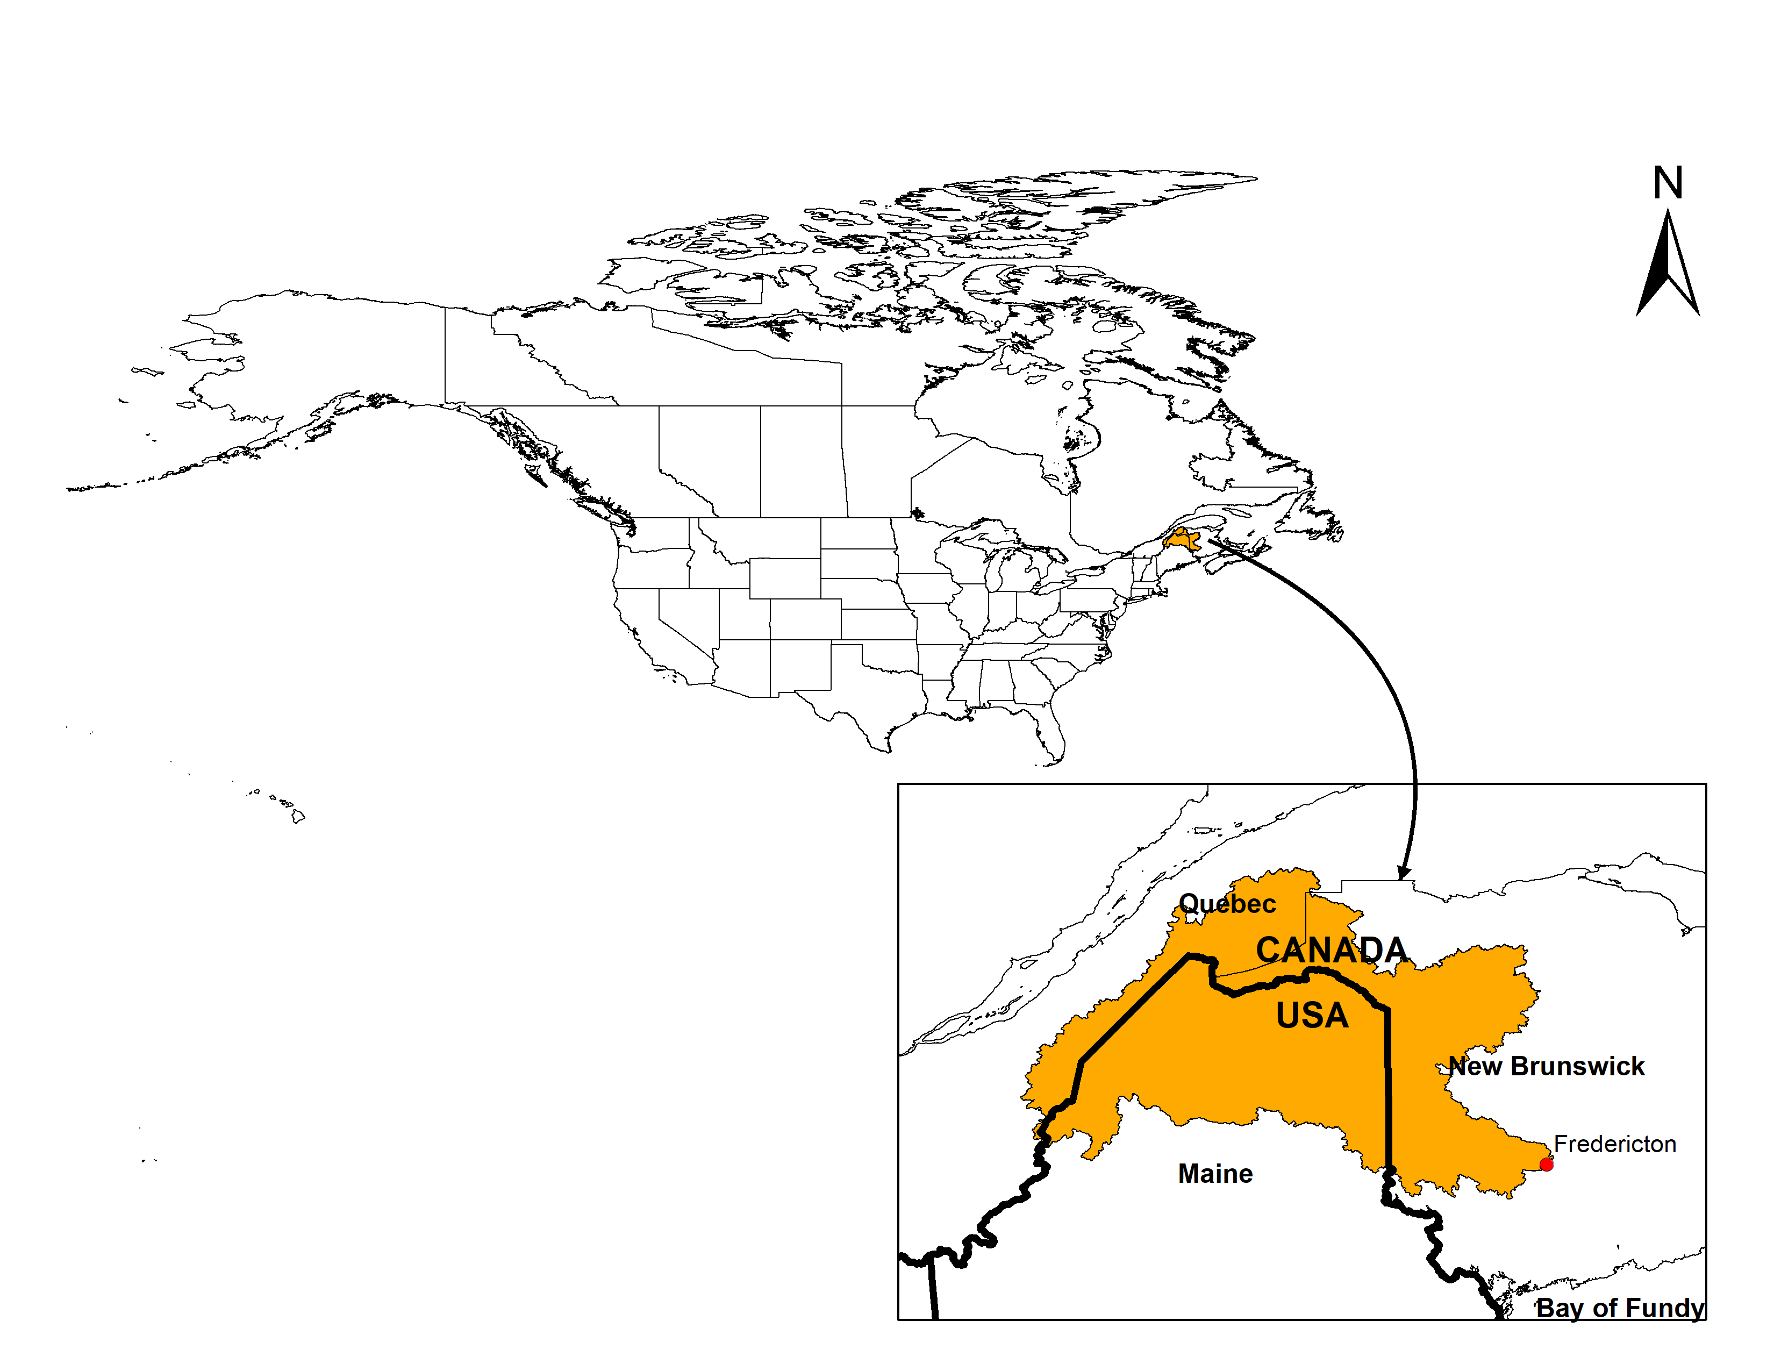
Fig: Location map of Saint John River Basin (SJRB)
Basin Characteristics
Coastal Basin in the state of Maine (36 %), province of Quebec (13%), and the province of New Brunswick (51%)
Mean annual precipitation is about 1100 mm (30% as snow)
Drainage area = 55,000 km²
Modelled basin Area = 41,000 km² (due to effect of tides and lack of discharge station downstream of Fredericton.

Slide 4
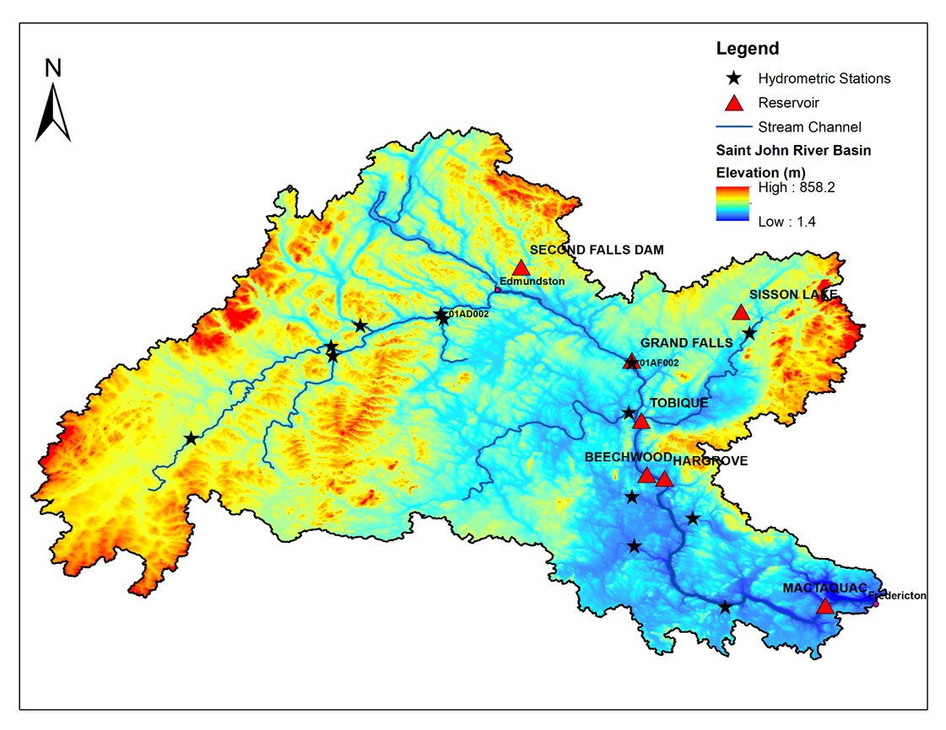
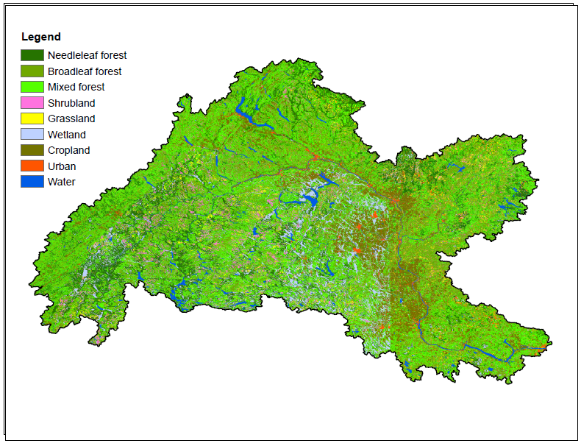
MESH model setup
Spatial resolution = 10 km
DEM: MERIT Hydro¹ (with hydrologically adjusted elevations)
Landcover: LANDSAT -30 m for North America
Soil data: Unified North American Soil Map (UNASM) ²
Streamflow: Water Survey of Canada, USGS and New Brunswick Power (reservoir data)
Reservoirs: Several reservoirs but run-of-the-river and comparison of inflows and outflows showed no discernable changes in hydrograph (R² = 0.98), so reservoir routine was not used
Fig: Modelling domain of SJRB
Fig: Landcover
Notes:
(a multi-jurisdictional data was needed due to transboundary issue)

Slide 5
Forcing Data Available For Hydrological Model
Forcing Inputs | Full Name | Record Length | Spatial/Temporal Resolution
GEM-CaPA³ | Global Environmental Multiscale and Canadian Precipitation Analysis | 2002 -2019 | 0.09-0.22˚ / 1 hour
WFDEI⁴ | European Union Integrated Project Water and Global Change (EU WATCH) ERA-Interim | 1979 -2016 | 0.5˚ / 3 hour
WFDEI-GEM-CaPA⁵ | Bias corrected WFDEI using GEM-CaPA | 1979 -2016 | 0.125˚ / 3 hour
CanRCM4-WFDEI -GEM-CaPA⁵ | Bias corrected CanRCM4 using WFDEI-GEM-CaPA (15 scenarios) | 1950-2100 | 0.125˚ / 3 hour
RDRS⁶ | Regional Deterministic Reforecast System | 2000-2017 | 0.125˚ / 1 hour

Slide 6
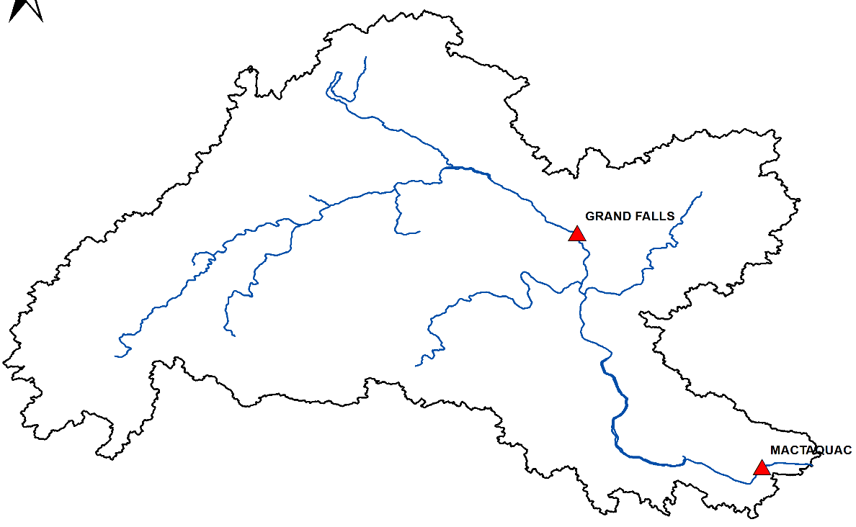
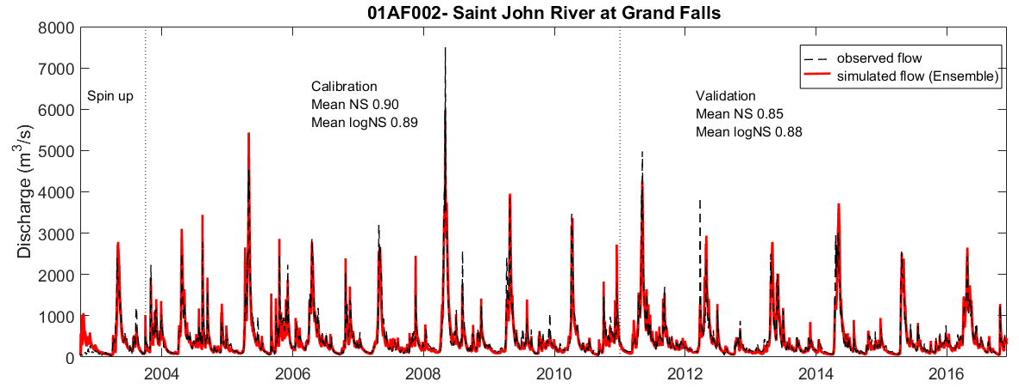
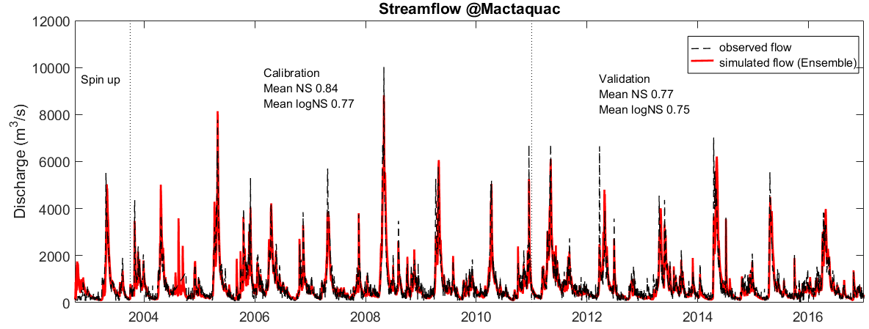
MESH calibration and validation
Met Forcing Data | Calibration |  | Validation
 | NS | NS_{log} | NS | NS_{log}
GEM-CaPA | 0.77 | 0.73 | 0.71 | 0.69
WFDEI | 0.53 | 0.52 | 0.41 | 0.37
WFDEI-GEM-CaPA | 0.77 | 0.65 | 0.66 | 0.64
RDRS | 0.84 | 0.77 | 0.77 | 0.75
Fig: Calibration and validation with RDRS

Slide 7
Simulation of baseline flow
Before simulating future climatic conditions, it is important to see how model performs under baseline period (using CanRCM4-WFDEI-GEM-CaPA).
Model simulated flows in baseline periods highlights two things:
The variability is less in simulated flows
Streamflows in spring months, particularly April and May is largely underestimated.
10 parameter sets
15 scenarios of CanRCM4-WGC
10 parameter sets
15 scenarios of CanRCM4-WGC

Slide 8
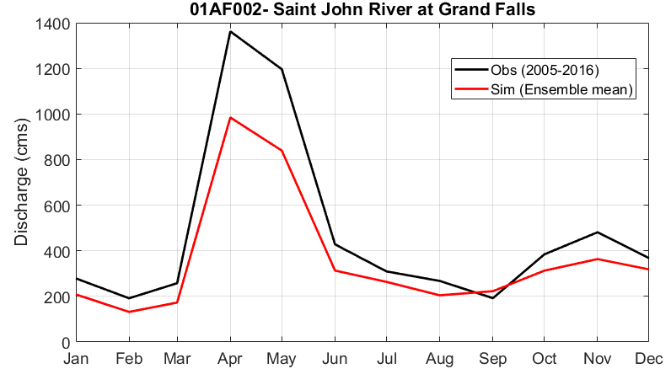
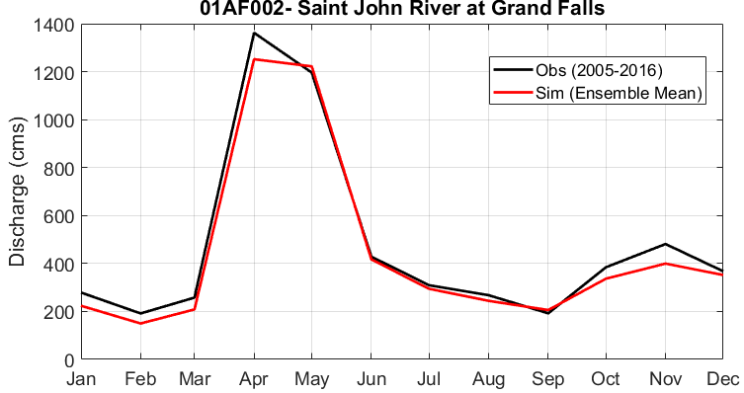
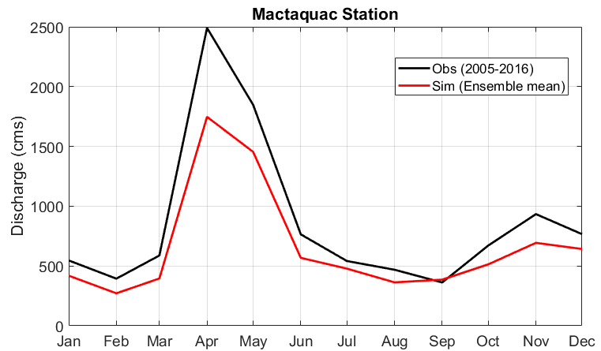
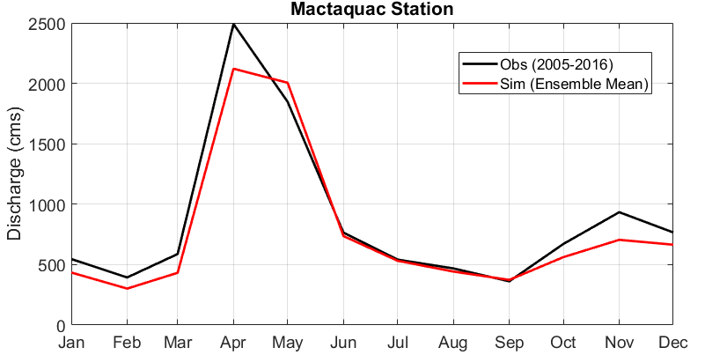
Where does the error stem from?
Even though calibration/validation results was reasonable for WFDEI-GEM-CaPA (>0.75 NSE at daily scale) the streamflow is underestimated in April and May.
RDRS captures better monthly variability.
Calibration with GEM-CaPA and WFDEI have also been done (not shown here) and are similar to WFDEI-GEM-CaPA results.
WFDEI-GEM-CaPA
RDRS
WFDEI-GEM-CaPA
RDRS
Take home message: A good NS or NS_{log} values in daily streamflow can be deceiving!

Slide 9
Streamflow under future climate
Calculated the relative difference between model simulated baseline period and model simulated future period.
Added the difference to the historical observed streamflow to get estimated future flows (Delta change method).
What we observe:
Increased winter flows between December to March
Decreased spring and summer flows between April to July
Based on 150 ensembles (median)
Based on 150 ensembles (median)

Slide 10
What about the uncertainty?
We know there is a huge uncertainty – our model was not able to simulate baseline conditions well!
So, we compared our model error vs changes in streamflow in future to see where model errors outweighs climate change signals or vice-versa.
What we observe:
Higher confidence that streamflows in Dec – Mar will be higher in future (model error<)
No/low confidence that summer flows in future will be lesser (model error >)

Slide 11
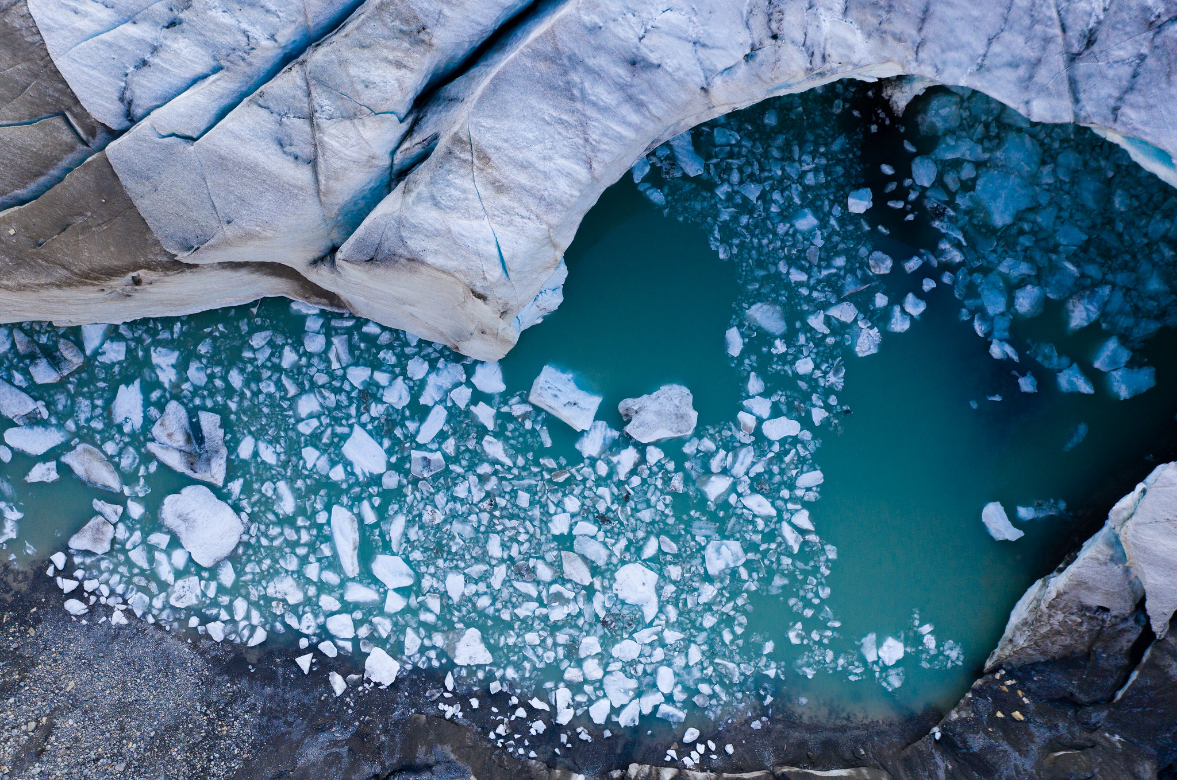
Thank you for your time!
Conclusion:
Model metrics can be deceiving!
Meteorological data play significant role in model performance (introduced the largest uncertainty).
Simulation of future flows in the SJRB shows that winter flows will increase but summer flows will decrease.
Evaluation of model error shows higher confidence in result that winter flows will increase but low confidence in result that summer flows will decrease.

Slide 12
Questions?

Slide 13
Forcing Data Available For Hydrological Model
Forcing Inputs | Full Name | Record Length | Spatial/Temporal Resolution
GEM-CaPA³ | Global Environmental Multiscale and Canadian Precipitation Anal | 2002 -2019 | 0.09-0.22˚ / 1 hour
WFDEI-GEM-CaPA⁴ | Bias corrected WFDEI using GEM-Ca | 1979 -2016 | 0.125˚ / 3 hour
CanRCM4-WFDEI -GEM-CaPA⁴ | Bias corrected CanRCM4 using WFDEI-GEM-CaPA (15 Ensemble member) | 1950-2100 | 0.125˚ / 3 hour
RDRS⁵ | Regional Deterministic Reforecast System | 2000-2017 | 0.125˚ / 1 hour

Slide 14
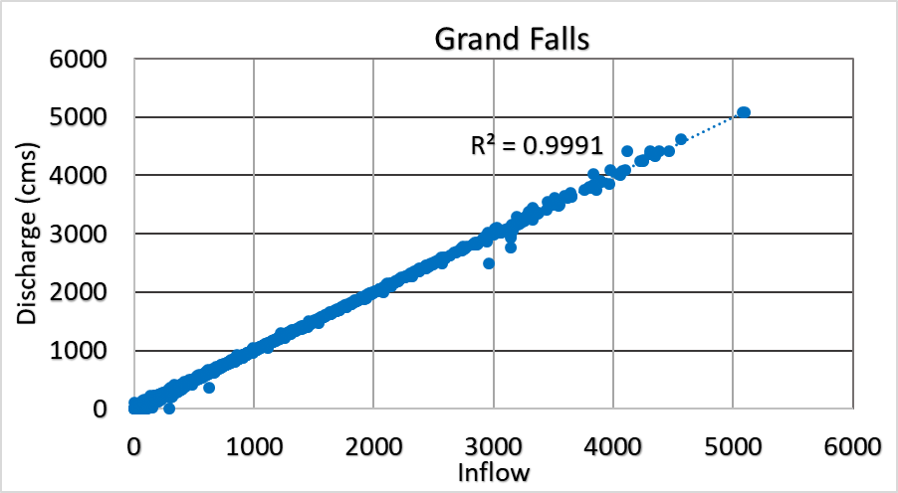
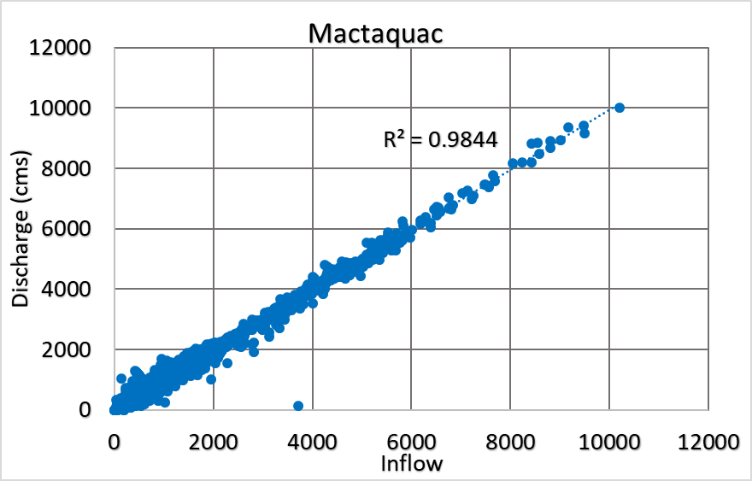
Reservoir inflow/outflows relationship
(a)
(b)
Fig: Relationship between inflows/outflows at (a) Grand Falls and (b) Mactaquac Reservoirs

Slide 15
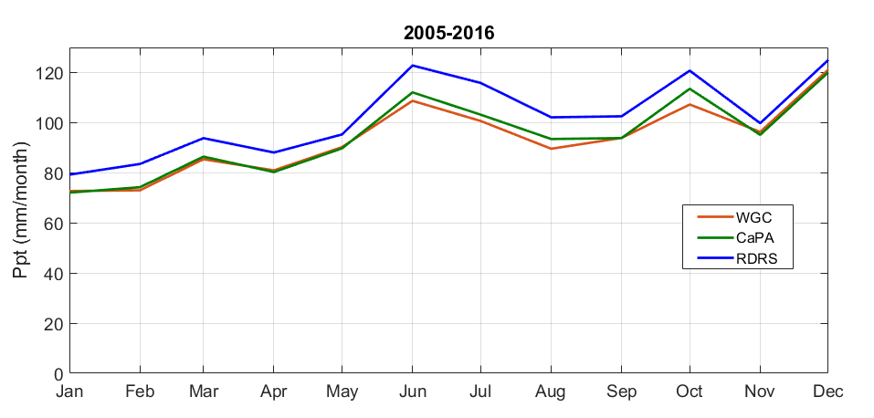
Precipitation Comparison (Basin average)
CaPA and WFDEI-GEM-CaPA (WGC) have similar average monthly patterns – meaning blended WGC products corresponds to CaPA
RDRS shows higher Basin average precipitation than CaPA

Slide 16
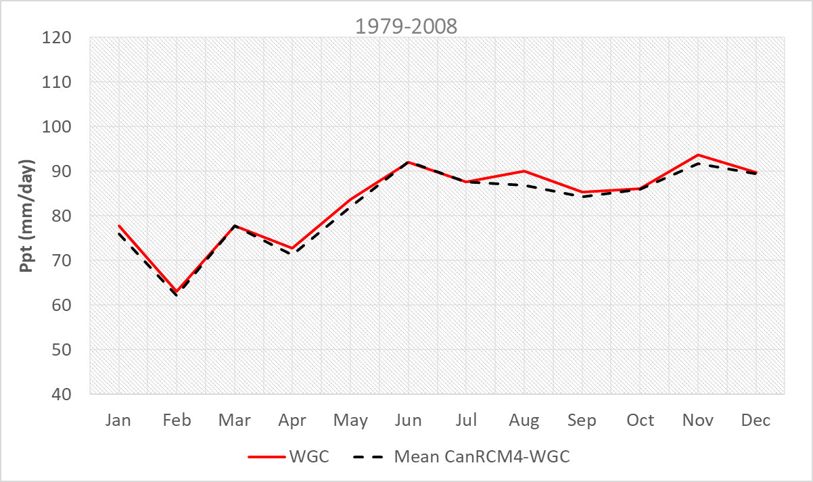
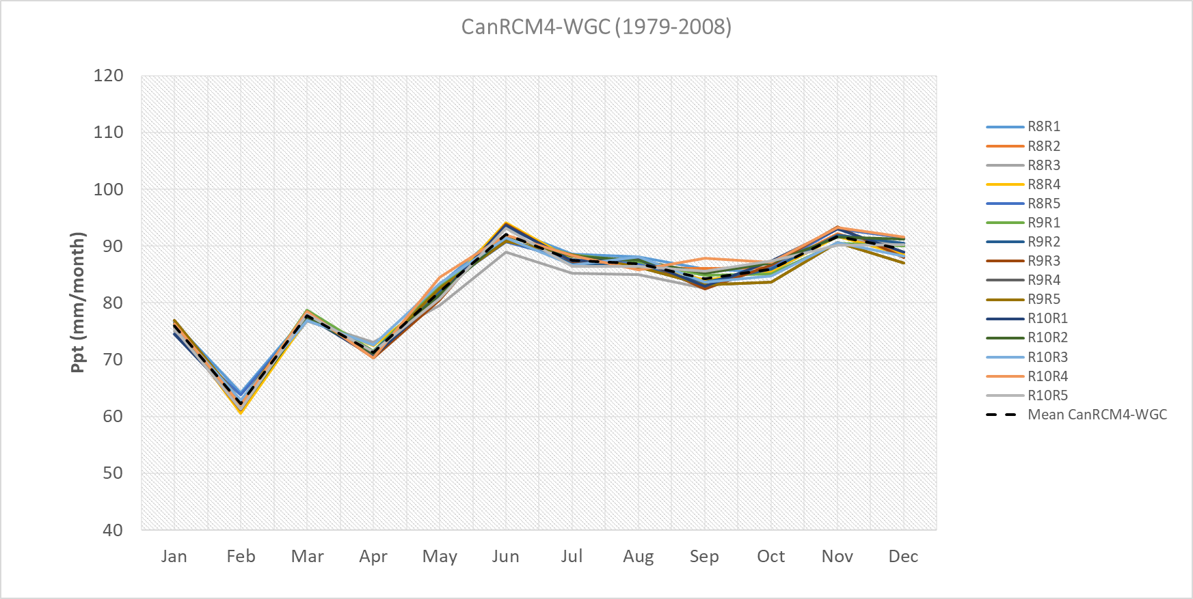
Precipitation Comparison (Basin average)
WGC and CanRCM4-WGC have similar average monthly patterns (bias correction worked reasonably)
Precipitation variability in 15 ensemble product of CanRCM4 with the mean

Slide 17
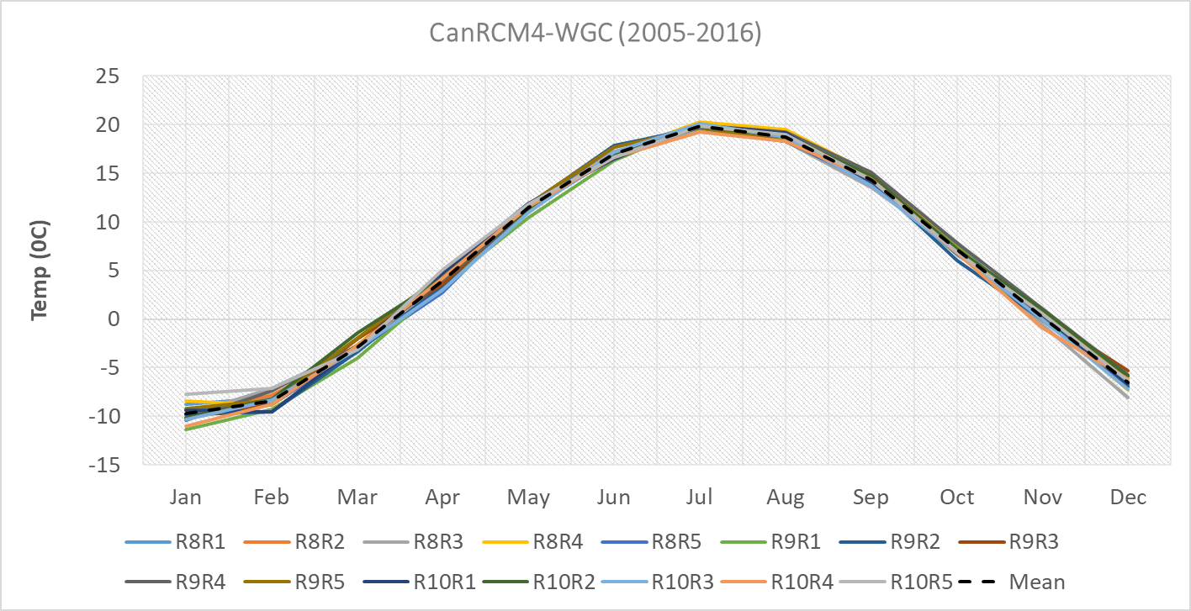
Temperature Comparison (Basin Average)
Unlike precipitation, temperature data show higher similarity with each other.
Ensembles of CanRCM4-WGC is also closer to mean.

Slide 18
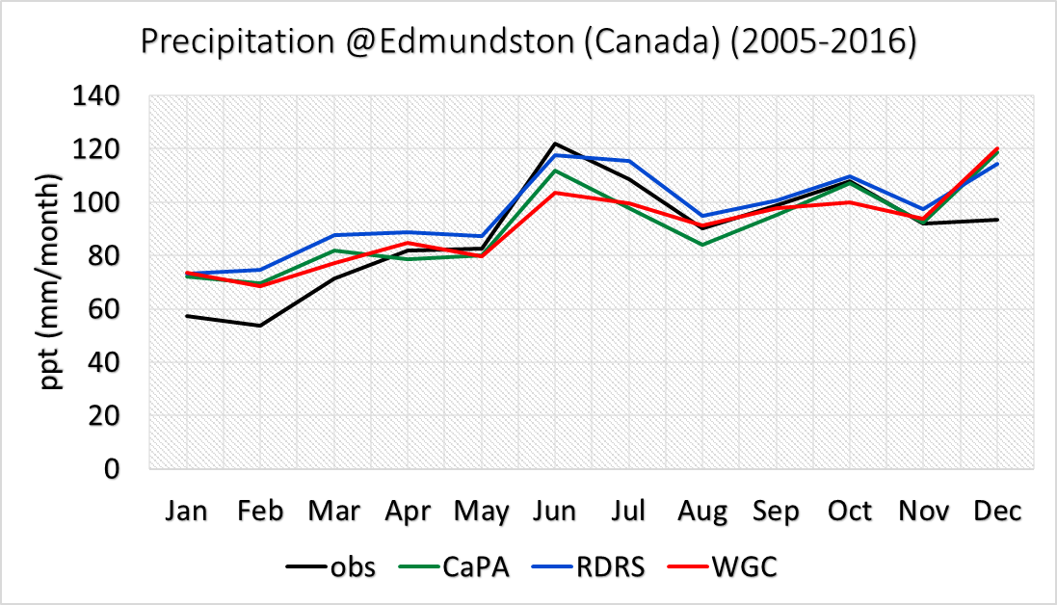
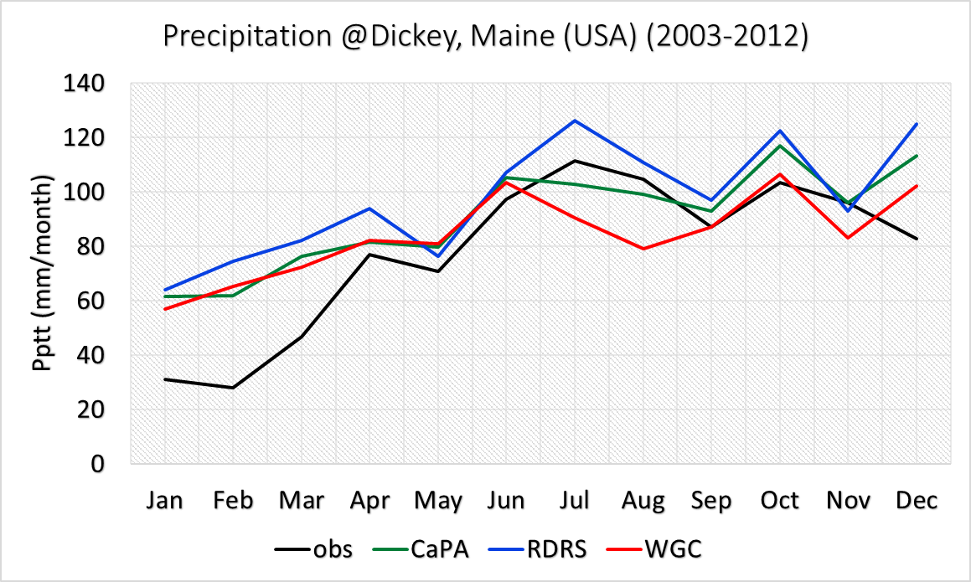
Precipitation Comparison
(at point station)
Comparison based on ECCC and USGS climate data from station in Edmundston and Dickey Maine resp.
Both CaPA and WGC underestimate summer (Jun July) precipitation event
RDRS is comparable to the station observation for summer month
But note that it is point observation compared against gridded data
Fig: Station observations at Edmundston (Canada) and Dickey Maine (USA)

Slide 19
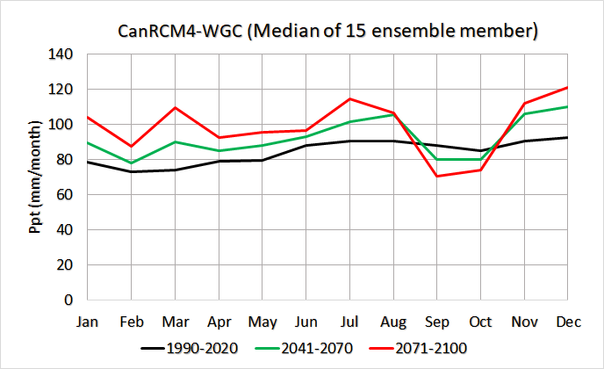
Historical-Future Precipitation
(Basin Average)

Slide 20
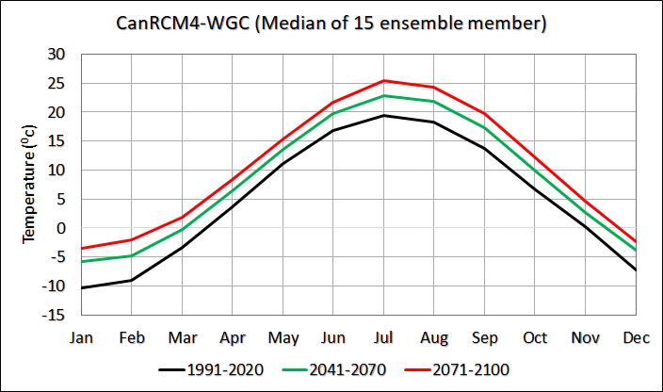
Historical-Future Temperature
(Basin Average)

Slide 21
References
Yamazaki, D., Ikeshima, D., Sosa, J., Bates, P. D., Allen, G. H., & Pavelsky, T. M. (2019). MERIT Hydro: a high‐resolution global hydrography map based on latest topography dataset. Water Resources Research, 55(6), 5053-5073
LIU, S., Wei, Y., Post, W., Cook, R., Schaefer, K., & Thornton, M. (2014). NACP MsTMIP: Unified North American Soil Map. ORNL DAAC.
Mahfouf, J. F., Brasnett, B., & Gagnon, S. (2007). A Canadian precipitation analysis (CaPA) project: Description and preliminary results. Atmosphere-ocean, 45(1), 1-17.
Weedon, G. P., Balsamo, G., Bellouin, N., Gomes, S., Best, M. J., and Viterbo, P.: The WFDEI meteorological forcing data set: WATCH Forcing Data methodology applied to ERA-Interim re- analysis data, Water Resour. Res., 50, 7505–7514, 2014.
Asong, Z. E., Elshamy, M. E., Princz, D., Wheater, H. S., Pomeroy, J. W., Pietroniro, A., & Cannon, A. (2020). High-resolution meteorological forcing data for hydrological modelling and climate change impact analysis in the Mackenzie River Basin. Earth Syst. Sci. Data, 12(1), 629-645. doi:10.5194/essd-12-629-2020
Gasset, N., Fortin, V., Dimitrijevic, M., Carrera, M., Bilodeau, B., Muncaster, R., . . . Khedhaouiria, D. (2021). A 10 km North American Precipitation and Land Surface Reanalysis Based on the GEM Atmospheric Model. Hydrol. Earth Syst. Sci. Discuss., 2021, 1-50. doi:10.5194/hess-2021-41

